Slide 1
WELCOME TO CORNELL

Slide 2
Orientation Group Meeting I
August 26, 2020

Slide 3
It’s Awesome to Meet You
Part I: Introduce Ourselves

Slide 4
Introduce Ourselves
Ice breaker: Two truths and a lie
Each person says three statements about themselves, two are true and one is not. Other members of our group will be guessing which one is false.

Slide 5
For Your and Our Safety
Part II: COVID-19 & Behavior Compact

Slide 6
2020-2021 Academic Calendar
https://registrar.cornell.edu/academic-calendar/2020-2021
Please refer to the academic calendar.

Slide 7
2020-2021 Academic Calendar: Fall
First day of classes: Wednesday, September 2, 2020
Online/Hybrid Instructions
Last day of on-campus classes: November 24, 2020
Thanksgiving Break, then all instructions go virtual
Last day of the term: Monday, December 21, 2020

Slide 8
2020-2021 Academic Calendar: Spring
Longer Winter Break
First day of classes: Tuesday, February 9, 2021
Current plan is to have a full residential spring semester
Last day of the term: Tuesday, May 25, 2021
To be adjusted

Slide 9
COVID-19 Updates
https://covid.cornell.edu/students/
https://covid.cornell.edu/students/behavioral-compact/

Slide 10
Student Behavioral Compact 2020-2021
Please read carefully through the “Cornell Student Behavioral Compact” document (labeled as “behavioral-compact.pdf” under “campus resources” folder).
This compact should also have appeared in your re-entry check-list.
Please read through the FAQs at https://covid.cornell.edu/students/behavioral-compact/.
Feel free to reach out to OS (Orientation Supervisor) or OL (Orientation Leader) if you have more questions!

Slide 11
You’re Always Supported
Part III: Campus Resources

Slide 12
Student & Campus Life Resources
https://scl.cornell.edu/

Slide 13
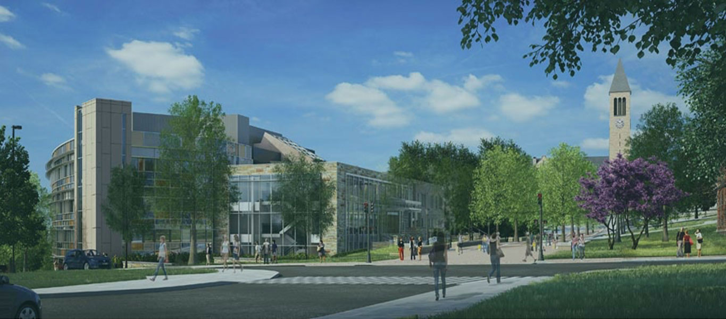
Cornell Health
https://health.cornell.edu/
110 Ho Plaza
+1 607-255-5155
Set up myCornellHealth account and complete your profile
Complete immunization requirements as early as possible

Slide 14
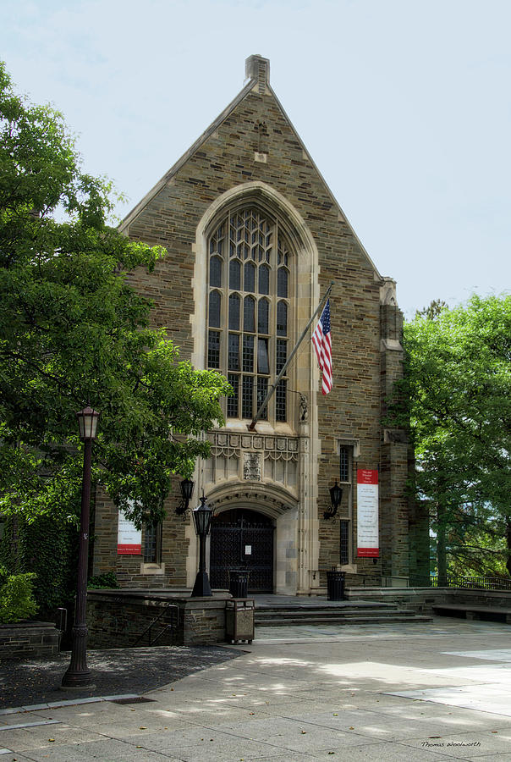
Care and Crisis Services
https://scl.cornell.edu/health-wellness/care-crisis-services
200 Willard Straight Hall
+1 607-254-8598
Emergency: +1 607-255-1111
Free popcorns

Slide 15
Mental Health Support & Crisis Services
Cornell Minds Matter (CMM)
https://cornell.campusgroups.com/cmm/cornell-minds-matter/
Leave of Absence Support Group
Empathy, Assistance and Referral Service (EARS)
https://www.earscornell.org/
Counselling & Psychological Services (CAPS)
https://health.cornell.edu/services/mental-health-care
24/7 Phone Consultation: +1 607-255-5155 (#2)
Cornell Police (See the back of your Student ID)

Slide 16
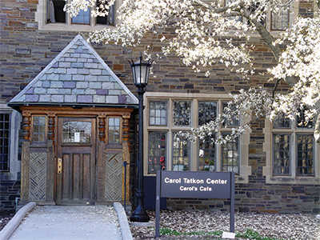
Tatkon Center for New Students and New Student Programs
https://scl.cornell.edu/residential-life/new-student-programs/tatkon-center-first-year-students
3058 Balch Hall
Enter from the door from the courtyard
Tutoring, Advising, Mental Health Support, etc.
Hot Chocolate & Puppies

Slide 17
College of Engineering
https://www.engineering.cornell.edu/students/undergraduate-students

Slide 18
Engineering Advising
Rhodes Hall, 1st floor
https://www.engineering.cornell.edu/students/undergraduate-students/advising
Faculty Advisor
Program Advisor
Peer Advisor: ENGRG 1050
1 credit, S/U
Mandatory Group Sessions
Course Selection
Major Affiliation
Undergrad Research
Career Opportunities
…

Slide 19
Engineering Learning Initiatives (ELI)
175 Rhodes Hall
https://www.engineering.cornell.edu/students/undergraduate-students/academic-opportunities-and-support/contact-us-engineering-learning
Academic Excellence Workshop (AEW)
MATH 1910, 1920, 2930 & 2940; CS 1110, 1112 & 2110; ENGRD 2700; CHEM 2090
Elementary Math Course Workshop
ELI Tutoring

Slide 20
Learning Strategies Center
http://lsc.cornell.edu/
Peer Tutoring

Slide 21
Other Important Resources
LGBT Resource Center
https://scl.cornell.edu/identity-resources/lgbt-resource-center
626 Thurston Ave, 3rd floor
Women’s Resource Center
https://scl.cornell.edu/identity-resources/womens-resource-center
209 Willard Straight Hall
Diversity & Inclusion
https://diversity.cornell.edu/

Slide 22
Other Important Resources
First Generation and Low-Income Student Support
https://scl.cornell.edu/identity-resources/first-generation-low-income-support
626 Thurston Ave, Room 305
Cornell United Religious Work (CURW)
http://www.curw.cornell.edu/
Annabel Taylor Hall
Identity-Based Program Housing
Asian and Asian American Center (A3C)
https://scl.cornell.edu/identity-resources/asian-asian-american-center-a3c
626 Thurston Ave, Room 305

Slide 23
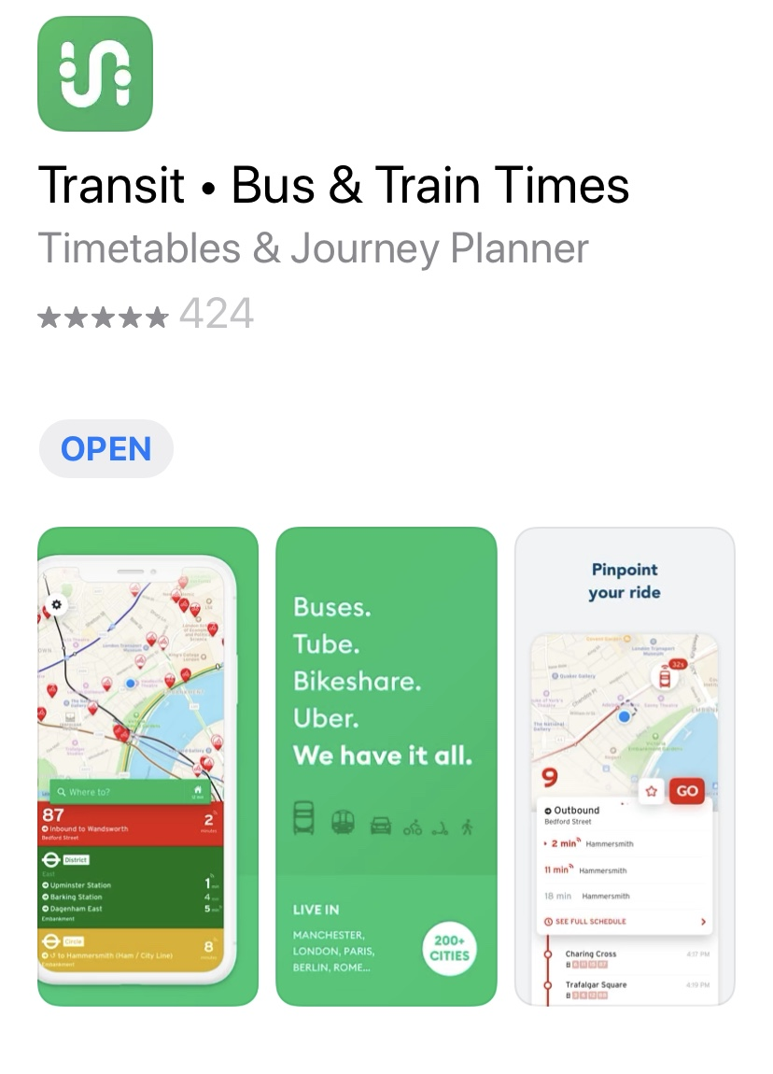
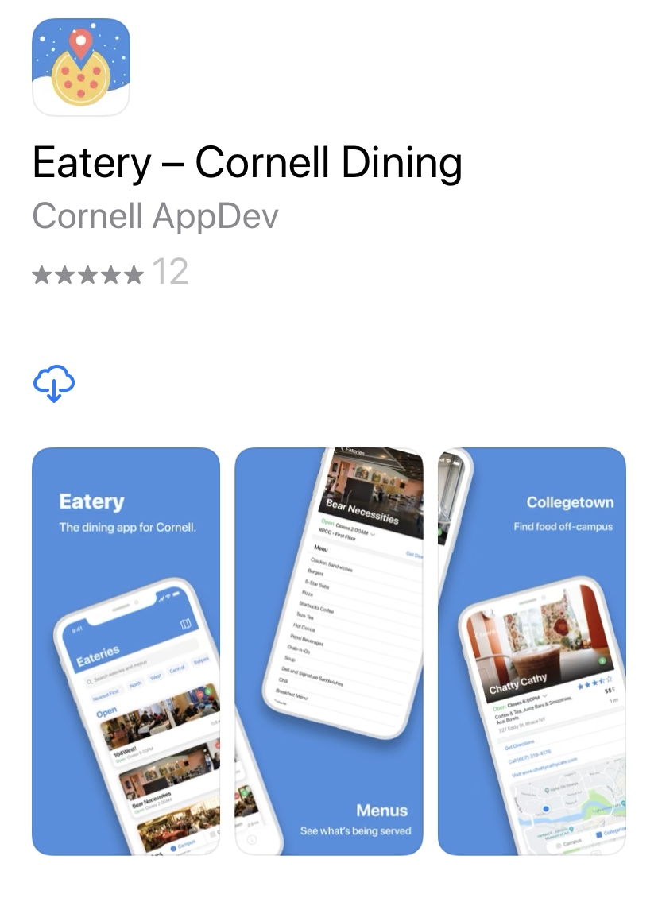
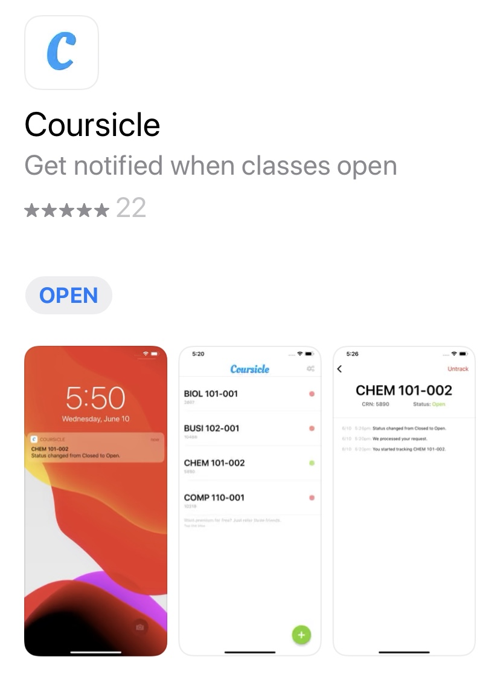
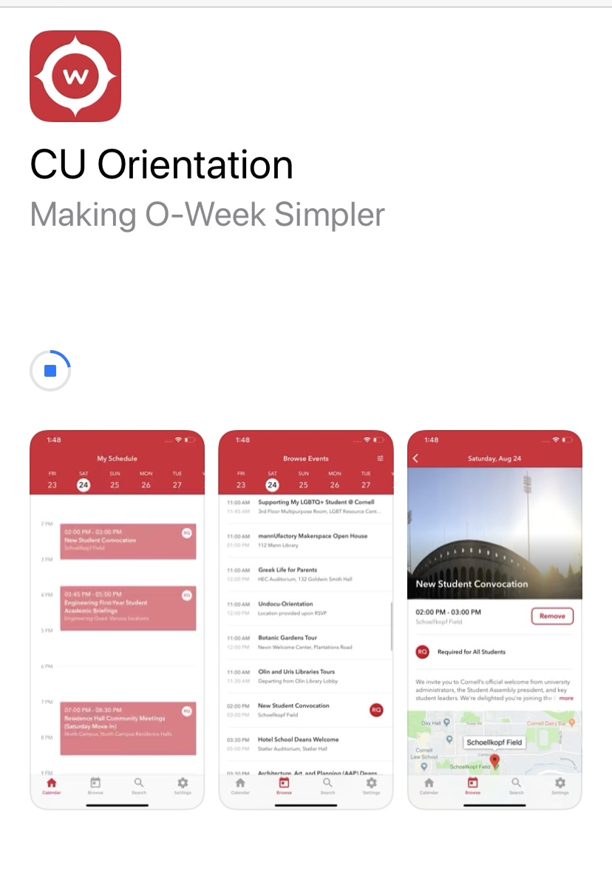
Useful Apps

Slide 24
Other Resources
Please refer to the Student & Campus Life website.

Slide 25
Thrive at Cornell
Part IV: Campus Involvement

Slide 26
ClubFest
Sept. 12-13, Sept. 19-20, Virtual
https://cornell.campusgroups.com./home_login
(netID login needed)

Slide 27
Sing at Cornell
https://www.singatcornell.com/
Chorus, Glee Club, Chorale, Chamber Singers
A Cappella Groups

Slide 28
Cornell Wind Symphony & Orchestras
Cornell Orchestras: https://www.cuorchestra.org/
Cornell Wind Symphony: https://cuwinds.com/

Slide 29
Engineering Project Teams
https://www.engineering.cornell.edu/students/undergraduate-students/special-programs/project-teams

Slide 30
Set Your First Semester Schedule
Part V: Enrollment

Slide 31
Contact Information
Contact OL
zl285@cornell.edu
See “contact info” folder
Group chat!
Contact OS/OSC
​orientation_cu@cornell.edu

Slide 32
Thank you! See you next meeting!

